Slide 1
IML END TERM ASSIGNMENT
The House Price Prediction Problem
By : Manisha Gupta – D21022
Sahil Gupta – D21030

Slide 2
Problem Statement :
In this problem, given a dataset that records the house prices of 9,761 houses in King County, Washington, US. The house prices are recorded along with some other attributes like - area of the house, number of bedrooms, number of bathrooms, number of floors etc.
We have to use this data given to explore the factors on which the price depends and build a model which will be able to predict the price of the house based on the set of predictors.
Objective : To predict the price of the house based on the various parameters.

Slide 3
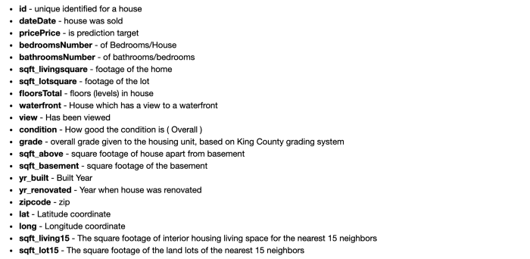
Understanding the Columns (Variables):

Slide 4
Initial Hypothesis and Assumptions :
The price of the house is dependent on the area of the house and the year built.
The price of the house also depends on the grade of the house.
The price of the house also depends on the number of bedrooms and bathrooms.
Let us do some EDA by plotting the graphs and understanding the variation the price of with respect to the variables.

Slide 5
EDA Process :
In this process we will analyze and find out the following :
Missing values.
All numerical variables.
Distribution of numerical variables.
All categorical variables.
Distribution of categorical variables.
Outliers.
Relationship between independent and dependent features(Price).

Slide 6
Results from EDA :
We do not have any missing values in our dataset . Hence we go forward with finding out the numerical and categorical variables.
We see that if the house is recently renovated then the price of the house is high.
We plot histograms to check the skewness for continuous numerical variables. We observe that features have normal distribution and some of them are skewed. If data is skewed we transform it into log normal distribution.
We plot the bar plots to study the relationship of discrete variables with price. The relationship between grade and price is exponential. We can see that all the features have monotonic relationship with Price. We can also see the have a positive correlation. As sqft_living increases the sales price of the house also increases, and same is for rest of the features.
From the EDA process we infer that the initial hypothesis and assumptions made by us were incorrect and the price of house depends on various other factors other than those taken in consideration during the hypothesis.

Slide 7

Model Fitting :
We try to fit Linear regression models on the training data and compute the R-squared and the RMSE values by doing a 10 fold cross validation on the training data. Below are the results for cross validation.
We find that as we increase the number of predictors we get a better Cross Validation score.
To further improve the model we apply feature engineering techniques like scaling, log transform and data encoding.

Slide 8
Feature Engineering :
We apply the following feature engineering steps to improve the performance of the model.
We transform the variable yr_built to the age of house in years.
We have seen that the numerical variables were skewed. We handle them taking the log transform of these variables.
Note : Here we should only take log transform of non-negative and non-zero columns. If we take log of negative and zero columns we might get NaN values.
3. Feature Scaling :
In this particular dataset we have many features which have different units. Hence it is necessary we do feature scaling to apply a particular machine learning algorithm.
We use MinMaxScaler which scales all the values between 0 and 1.
Note : We need to perform feature engineering on both the datasets i.e. training data and test data.

Slide 9

Model fitting after feature engineering :
We try to fit the above models post feature engineering to see if the performance of the model has improved after feature engineering. We try to fit Linear regression models on the training data and compute the R-squared and the RMSE values by doing a 10 fold cross validation on the training data. Below are the results for cross validation.
We can observe that with feature engineering and increasing number of predictors there is a slight improvement in the performance of the model.

Slide 10

Linear Regression with R squared & RMSE score :
We perform a Linear Regression on the featured data and test the model on the featured test data to get the R squared and RMSE score.
Here we consider all the numerical variables in the dataset after feature engineering as the set of predictors and price as the target. We drop zip code, id and date from the predictors.
We can see that the performance of the model increases as we increase the number of predictors.

Slide 11

Fitting Decision Tree on Unfeatured data :
We try to fit Decision Tree regression models on the train data and compute the R-squared and the RMSE values by doing a 10 fold cross validation on the training data, taking into considerations the initial hypothesis and the assumptions.

Slide 12

Fitting Decision Tree on Featured data :
We try to fit Decision Tree regression models on the train data and compute the R-squared and the RMSE values by doing a 10 fold cross validation on the training data, taking into considerations the initial hypothesis and the assumptions.
We can observe that with feature engineering and increasing number of predictors there is a slight improvement in the performance of the model.

Slide 13
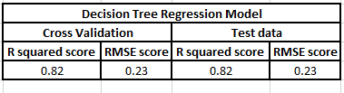
Decision Tree with R squared & RMSE score:
We fit a Decision Tree Regression model on the featured data and test the model on the featured test data to get the R squared and RMSE score.
Here we consider all the numerical variables in the dataset after feature engineering as the set of predictors and price as the target. We drop zip code, id and date from the predictors.
We perform a hyper parameter tuning to get the best fit model. Below are the metrics for best fit model with R squared = 0.82.

Slide 14
Comparison between Models :
From the above comparison we can conclude that a Decision Tree model with all numerical variables as the predictors except id, date and zip code and having a maximum depth of 10 is the best fit model for the prediction of the house prices.

Slide 15
THANK YOU

